Slide 1
{Convolutional} Neural Networks
Radu Ionescu Bogdan Alexe
raducu.ionescu@gmail.com bogdan.alexe@fmi.unibuc.ro
Faculty of Mathematics and Computer Science
University of Bucharest

Slide 2
The evolution of learning methods
1950s: the introduction of the perceptron (Rosenblatt, 1957)
1980s: the back-propagation algorithm for training multi-layer perceptron becomes widely popular (Hinton, 1986)
1990s: the introduction of kernel methods (Cortes, 1995)

Slide 3
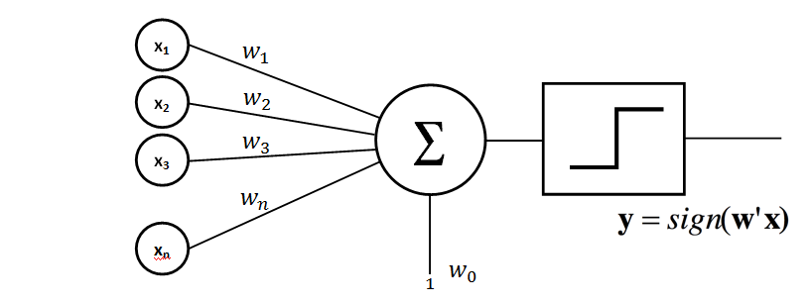
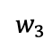
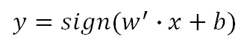
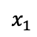
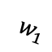
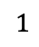
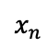
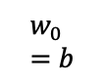
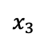
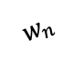
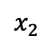
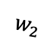
The Perceptron
$$x_{1}$$
$$w_{1}$$
$$x_{2}$$
$$w_{2}$$
$$w_{3}$$
$$x_{3}$$
$$w_{n}$$
$$y=sign(w^{′}∙x+b)$$
$$w_{0}=b$$
$$x_{n}$$
$$1$$

Slide 4
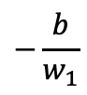

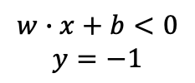

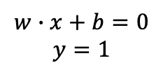
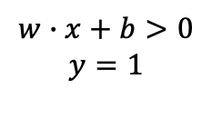
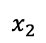
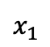
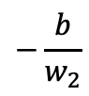
Linear separating hyperplane
$$x_{2}$$
$$w$$
$$w∙x+b>0$$
$$y=1$$
1
$$−\frac{b}{w_{1}}$$
$$w∙x+b=0$$
$$y=1$$
$$x_{1}$$
-1
1
$$w∙x+b<0$$
$$y=−1$$
$$−\frac{b}{w_{2}}$$
-1
Where $w_{1}=−1$,$w_{2}=1$, $b=1$

Slide 5
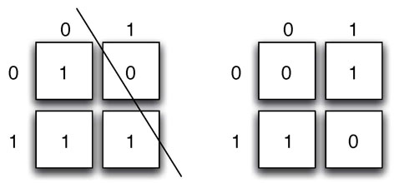

XOR (Minsky & Papert, 1969)
A linear classification method cannot solve the XOR problem

Slide 6
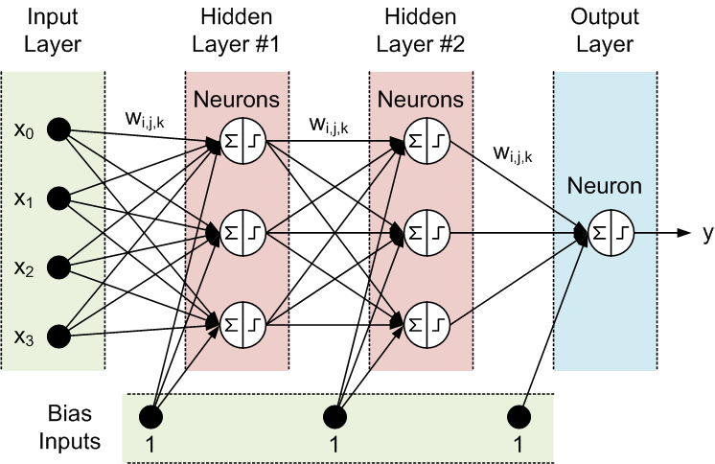
Solution: Neural Networks

Slide 7


From feature extract to end-to-end learning
vector describing various image statistics
f
Feature Extraction
N numbers, indicating class scores
training
[32x32x3]
f
N numbers, indicating class scores
training
[32x32x3]

Slide 8
Gradient Descent (Python)
def GD(W0, X, goal, learningRate):
perfGoalNotMet = true
W = W0
while perfGoalNotMet:
gradient = eval_gradient(X, W)
W_old = W
W = W – learningRate * gradient
perfGoalNotMet = sum(abs(W - W_old)) > goal

Slide 9
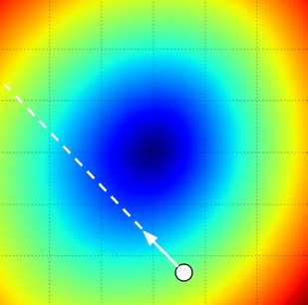
W₂
current W
W₁
negative gradient direction

Slide 10
Mini-batch Gradient Descent
Also known as Stochastic Gradient Descent (SGD)
Only use a small portion of the training set to compute the gradient:
. . .
while perfGoalNotMet:
X_batch = select_random_subsample(X)
gradient = eval_gradient(@loss, X_batch, W)
. . .
Common mini-batch sizes are 32/64/128 examples
e.g. Krizhevsky’s ILSVRC ConvNet used 256 examples

Slide 11
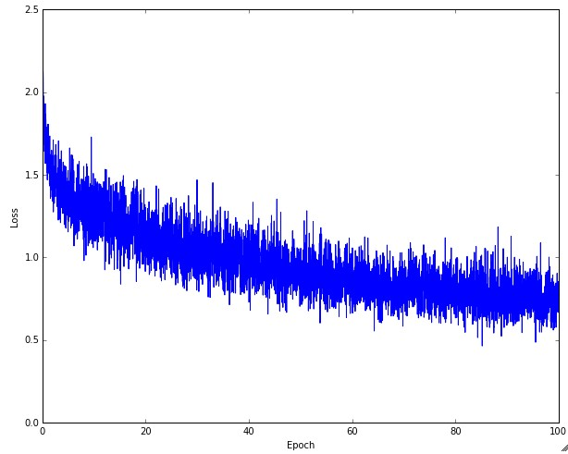
Example of optimization progress while training a neural network with SGD.
(Loss over mini-batches goes down over time)

Slide 12

The effects of step size (or “learning rate”)

Slide 13
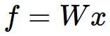

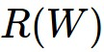
Computational Graph
x
*
s (scoruri)
Hinge loss
+
L
W
R

Slide 14
Convolutional Network
(AlexNet)
input image
weights
loss

Slide 15
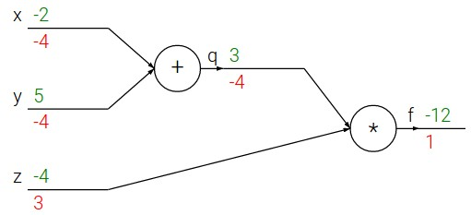
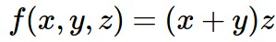
e.g. x = -2, y = 5, z = -4

Slide 16
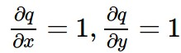
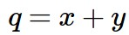
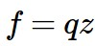
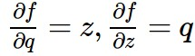
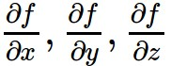
e.g. x = -2, y = 5, z = -4
Want:

Slide 17
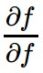
e.g. x = -2, y = 5, z = -4
Want:

Slide 18
e.g. x = -2, y = 5, z = -4
Want:

Slide 19
e.g. x = -2, y = 5, z = -4
Want:

Slide 20
e.g. x = -2, y = 5, z = -4
Want:

Slide 21
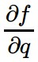
e.g. x = -2, y = 5, z = -4
Want:

Slide 22
e.g. x = -2, y = 5, z = -4
Want:

Slide 23
e.g. x = -2, y = 5, z = -4
Want:

Slide 24
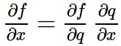
e.g. x = -2, y = 5, z = -4
Chain rule:
Want:

Slide 25
e.g. x = -2, y = 5, z = -4
Want:

Slide 26
e.g. x = -2, y = 5, z = -4
Chain rule:
Want:

Slide 27
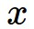
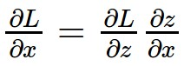
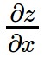
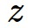
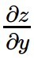
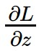
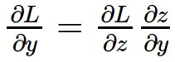
Gradient propagation using chain rule
activations
f
“local gradient”
gradients

Slide 28
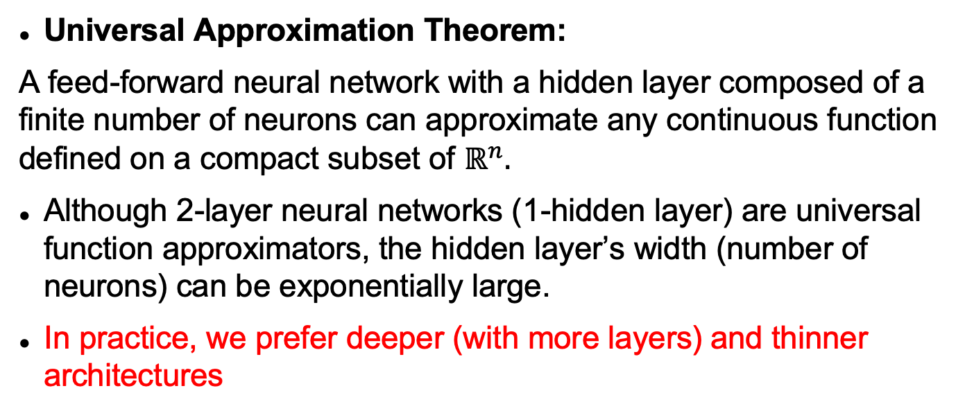
Neural networks are
universal function approximators
Universal Approximation Theorem:
A feed-forward neural network with a hidden layer composed of a finite number of neurons can approximate any continuous function defined on a compact subset of $ℝ^{n}.$
Although 2-layer neural networks (1-hidden layer) are universal function approximators, the hidden layer’s width (number of neurons) can be exponentially large.
In practice, we prefer deeper (with more layers) and thinner architectures

Slide 29

Convolutional Neural Networks
[LeNet-5, LeCun 1998]

Slide 30
Convolution Layer
Filters always extend the full depth of the input volume
32x32x3 image
5x5x3 filter
32
height
Convolve the filter with the image
i.e. “slide over the image spatially, computing dot products”
32
width
3
depth

Slide 31

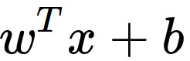
Convolution Layer
32x32x3 image
5x5x3 filter
32
1 number:
The result of taking a dot product between the filter and a small 5x5x3 chunk of the image
(i.e. 5*5*3 = 75-dimensional dot product + bias)
32
3

Slide 32
Convolution Layer
32x32x3 image
5x5x3 filter
activation map
32
28
Convolve (slide) over all spatial locations
32
28
3
1

Slide 33
Convolution Layer
32x32x3 image
5x5x3 filter
activation maps
32
28
Convolve (slide) over
all spatial locations
32
28
3
1
Consider a second, green filter

Slide 34
For example, if we had 6 5x5 filters, we’ll get 6 separate activation maps:
activation maps
32
28
Convolution Layer
32
28
3
6
We stack these up to get a “new image” of size 28x28x6!

Slide 35
Preview: A ConvNet is a sequence of Convolutional Layers, interposed with activation functions
32
28
24
….
CONV,
ReLU
e.g. 6 5x5x3 filters
CONV,
ReLU
e.g. 10 5x5x6 filters
CONV,
ReLU
32
28
24
3
6
10

Slide 36

Filters correspond to features / parts of the objects
[Slide credit: Yann LeCun]

Slide 37
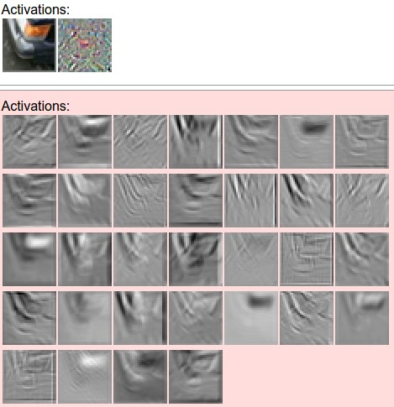
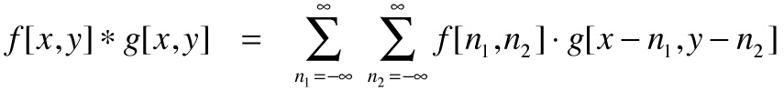
one filter =>
one activation map
example 5x5 filters
(32 total)
We call the layer convolutional because it is related to convolution of two signals:
elementwise multiplication and sum of a filter and the signal (image)

Slide 38


Maximum activation = highest response
https://commons.wikimedia.org/wiki/File:Convolution_of_box_signal_with_itself.gif

Slide 39


Slide 40
Size of an activation map
activation map
32x32x3 image
5x5x3 filter
32
28
Convolve (slide) over all spatial locations
32
28
3
1

Slide 41
Size of an activation map
7
7x7 input (spatially, without depth)
assume 3x3 filter
7

Slide 42
Size of an activation map
7
7x7 input (spatially, without depth)
assume 3x3 filter
7

Slide 43
Size of an activation map
7
7x7 input (spatially, without depth)
assume 3x3 filter
7

Slide 44
Size of an activation map
7
7x7 input (spatially, without depth)
assume 3x3 filter
7

Slide 45
Size of an activation map
7
7x7 input (spatially, without depth)
assume 3x3 filter
=> 5x5 output
7

Slide 46
Size of an activation map
7
7x7 input (spatially)
assume 3x3 filter
applied with stride 2
7

Slide 47
Size of an activation map
7
7x7 input (spatially)
assume 3x3 filter
applied with stride 2
7

Slide 48
Size of an activation map
7
7x7 input (spatially)
assume 3x3 filter
applied with stride 2
=> 3x3 output!
7

Slide 49
Size of an activation map
7
7x7 input (spatially)
assume 3x3 filter
applied with stride 3?
7

Slide 50
Size of an activation map
7
7x7 input (spatially)
assume 3x3 filter
applied with stride 3?
7
It does not fit!
We cannot apply a 3x3 filter on an image of 7x7 pixels using a stride of 3

Slide 51
Size of an activation map
N
Output size:
(N - F) / stride + 1
e.g. N = 7, F = 3:
stride 1 => (7 - 3)/1 + 1 = 5
stride 2 => (7 - 3)/2 + 1 = 3
stride 3 => (7 - 3)/3 + 1 = 2.33 :(
F
N
F

Slide 52
In practice: Common to zero pad the border
0 | 0 | 0 | 0 | 0 | 0
0
0
0
0
e.g. input 7x7
3x3 filter, applied with stride 1
pad with 1 pixel border => what is the output?
(recall:)
(N - F) / stride + 1

Slide 53
In practice: Common to zero pad the border
0 | 0 | 0 | 0 | 0 | 0
0
0
0
0
e.g. input 7x7
3x3 filter, applied with stride 1
pad with 1 pixel border => what is the output?
7x7 output!

Slide 54
In practice: Common to zero pad the border
0 | 0 | 0 | 0 | 0 | 0
0
0
0
0
e.g. input 7x7
3x3 filter, applied with stride 1
pad with 1 pixel border => what is the output?
7x7 output!
In general, common to see CONV layers with stride 1, filters of size FxF, and zero-padding with (F-1)/2. (preserves the size of the input image / activation map)
e.g. F = 3 => zero pad with 1 (value 0)
F = 5 => zero pad with 2 (value 0)
F = 7 => zero pad with 3 (value 0)

Slide 55
32x32 input convolved repeatedly with 5x5 filters shrinks volumes spatially!
(32 => 28 => 24 ...)
Shrinking too fast is not good, doesn’t work well.
32
28
24
….
CONV,
ReLU
e.g. 6 5x5x3 filters
CONV,
ReLU
e.g. 10 5x5x6 filters
CONV,
ReLU
32
28
24
3
6
10

Slide 56
Examples time:
Input volume: 32x32x3
10 5x5 filters with stride 1, pad 2
Output volume size: ?

Slide 57
Examples time:
Input volume: 32x32x3
10 5x5 filters with stride 1, pad 2
Output volume size:
(32+2*2-5)/1+1 = 32 spatially,
so the volume is
32x32x10

Slide 58
Examples time:
Input volume: 32x32x3
10 5x5 filters with stride 1, pad 2
Number of parameters in this layer?

Slide 59
Examples time:
Input volume: 32x32x3
10 5x5 filters with stride 1, pad 2
Number of parameters in this layer?
Each filter has 5*5*3 + 1 = 76 params (+1 for bias)
=> 76*10 = 760

Slide 60
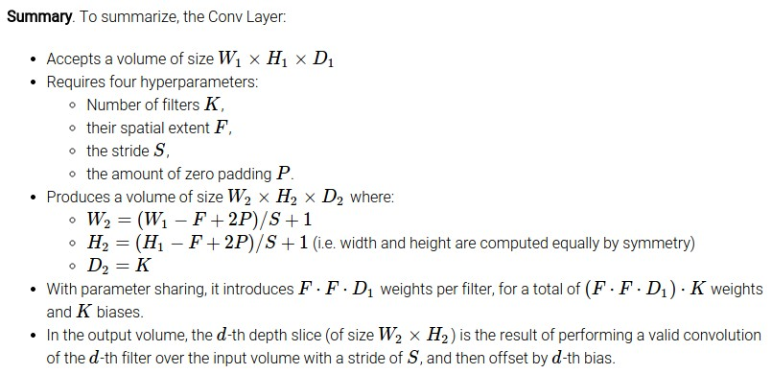
Common settings:
K = (powers of 2, e.g. 32, 64, 128, 512)
F = 3, S = 1, P = 1
F = 5, S = 1, P = 2
F = 5, S = 2, P = ? (whatever fits)
F = 1, S = 1, P = 0

Slide 61
Btw, 1x1 convolutional layers make perfect sense
1x1 CONV
with 32 filters
56
56
(each filter has size 1x1x64, and performs a 64-dimensional dot product)
56
56
64
32

Slide 62
Two more layers to go: POOL/FC

Slide 63

Pooling layer
Makes the representations smaller and more manageable
Operates over each activation map independently:

Slide 64
MAX Pooling
Single depth slice
1 | 1 | 2 | 4
5 | 6 | 7 | 8
3 | 2 | 1 | 0
1 | 2 | 3 | 4
x
max pool with 2x2 filters and stride 2
6 | 8
3 | 4
y

Slide 65
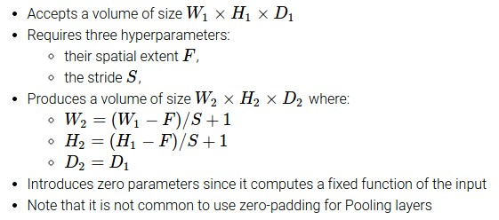
Common settings:
F = 2, S = 2
F = 3, S = 2

Slide 66
Fully-Connected Layer (FC layer)
Contains neurons that connect to the entire input volume, just as in ordinary Neural Networks

Slide 67
Case Study: LeNet-5
[LeCun et al., 1998]
Conv filters were 5x5, applied at stride 1
Subsampling (Pooling) layers were 2x2, applied at stride 2
i.e. architecture is [CONV-POOL-CONV-POOL-CONV-FC]

Slide 68
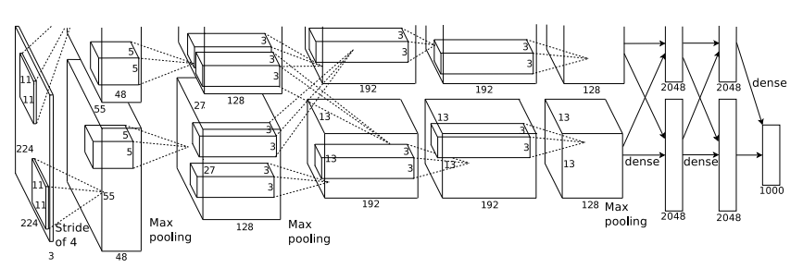
Case Study: AlexNet
[Krizhevsky et al. 2012]
Input: 227x227x3 images
First layer (CONV1): 96 11x11 filters applied at stride 4
=>
Q: What is the output volume size?
Hint: (227-11)/4+1 = 55

Slide 69
Case Study: AlexNet
[Krizhevsky et al. 2012]
Input: 227x227x3 images
First layer (CONV1): 96 11x11 filters applied at stride 4
=>
Output volume [55x55x96]
Q: What is the total number of parameters in this layer?

Slide 70
Case Study: AlexNet
[Krizhevsky et al. 2012]
Input: 227x227x3 images
First layer (CONV1): 96 11x11 filters applied at stride 4
=>
Output volume [55x55x96]
Parameters: (11*11*3)*96 = 35K

Slide 71
Case Study: AlexNet
[Krizhevsky et al. 2012]
Input: 227x227x3 images
After CONV1: 55x55x96
Second layer (POOL1): 3x3 filters applied at stride 2
Q: What is the output volume size?
Hint: (55-3)/2+1 = 27

Slide 72
Case Study: AlexNet
[Krizhevsky et al. 2012]
Input: 227x227x3 images
After CONV1: 55x55x96
Second layer (POOL1): 3x3 filters applied at stride 2
Output volume: 27x27x96
Q: What is the number of parameters in this layer?

Slide 73
Case Study: AlexNet
[Krizhevsky et al. 2012]
Input: 227x227x3 images
After CONV1: 55x55x96
Second layer (POOL1): 3x3 filters applied at stride 2
Output volume: 27x27x96
Parameters: 0

Slide 74
Case Study: AlexNet
[Krizhevsky et al. 2012]
Input: 227x227x3 images
After CONV1: 55x55x96
After POOL1: 27x27x96
...

Slide 75
Case Study: AlexNet
[Krizhevsky et al. 2012]
Full (simplified) AlexNet architecture:
[227x227x3] INPUT
[55x55x96] CONV1: 96 11x11 filters at stride 4, pad 0
[27x27x96] MAX POOL1: 3x3 filters at stride 2
[27x27x96] NORM1: Normalization layer
[27x27x256] CONV2: 256 5x5 filters at stride 1, pad 2
[13x13x256] MAX POOL2: 3x3 filters at stride 2
[13x13x256] NORM2: Normalization layer
[13x13x384] CONV3: 384 3x3 filters at stride 1, pad 1
[13x13x384] CONV4: 384 3x3 filters at stride 1, pad 1
[13x13x256] CONV5: 256 3x3 filters at stride 1, pad 1
[6x6x256] MAX POOL3: 3x3 filters at stride 2
[4096] FC6: 4096 neurons
[4096] FC7: 4096 neurons
[1000] FC8: 1000 neurons (class scores)
Details/Retrospectives:
- First use of ReLU
- Used Norm layers (not common anymore)
- Heavy data augmentation
- Dropout 0.5
- Batch size 128
- SGD Momentum 0.9
- Learning rate 1e-2, reduced by 10
manually when validation accuracy plateaus
- L2 weight decay 5e-4
- 7 CNN ensemble: 18.2% -> 16.4%

Slide 76
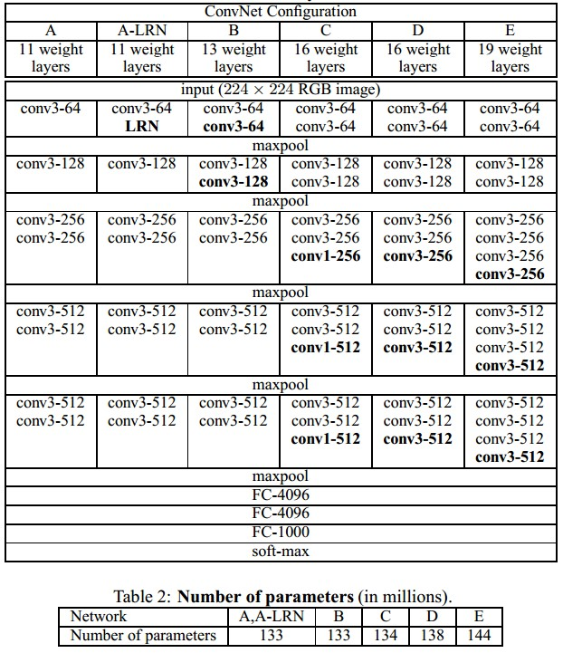
Case Study: VGGNet
[Simonyan and Zisserman, 2014]
Only 3x3 CONV stride 1, pad 1
and 2x2 MAX POOL stride 2
Best model
11.2% top 5 error in ILSVRC 2013
=>
7.3% top 5 error

Slide 77

(not counting biases)
INPUT: [224x224x3] memory: 224*224*3=150K params: 0
CONV3-64: [224x224x64] memory: 224*224*64=3.2M params: (3*3*3)*64 = 1,728
CONV3-64: [224x224x64] memory: 224*224*64=3.2M params: (3*3*64)*64 = 36,864
POOL2: [112x112x64] memory: 112*112*64=800K params: 0
CONV3-128: [112x112x128] memory: 112*112*128=1.6M params: (3*3*64)*128 = 73,728
CONV3-128: [112x112x128] memory: 112*112*128=1.6M params: (3*3*128)*128 = 147,456
POOL2: [56x56x128] memory: 56*56*128=400K params: 0
CONV3-256: [56x56x256] memory: 56*56*256=800K params: (3*3*128)*256 = 294,912
CONV3-256: [56x56x256] memory: 56*56*256=800K params: (3*3*256)*256 = 589,824
CONV3-256: [56x56x256] memory: 56*56*256=800K params: (3*3*256)*256 = 589,824
POOL2: [28x28x256] memory: 28*28*256=200K params: 0
CONV3-512: [28x28x512] memory: 28*28*512=400K params: (3*3*256)*512 = 1,179,648
CONV3-512: [28x28x512] memory: 28*28*512=400K params: (3*3*512)*512 = 2,359,296
CONV3-512: [28x28x512] memory: 28*28*512=400K params: (3*3*512)*512 = 2,359,296
POOL2: [14x14x512] memory: 14*14*512=100K params: 0
CONV3-512: [14x14x512] memory: 14*14*512=100K params: (3*3*512)*512 = 2,359,296
CONV3-512: [14x14x512] memory: 14*14*512=100K params: (3*3*512)*512 = 2,359,296
CONV3-512: [14x14x512] memory: 14*14*512=100K params: (3*3*512)*512 = 2,359,296
POOL2: [7x7x512] memory: 7*7*512=25K params: 0
FC: [1x1x4096] memory: 4096 params: 7*7*512*4096 = 102,760,448
FC: [1x1x4096] memory: 4096 params: 4096*4096 = 16,777,216
FC: [1x1x1000] memory: 1000 params: 4096*1000 = 4,096,000
TOTAL memory: 24M * 4 bytes ~= 93MB / image (only forward! ~x2 for backward)
TOTAL params: 138M parameters

Slide 78
(not counting biases)
INPUT: [224x224x3] memory: 224*224*3=150K params: 0
CONV3-64: [224x224x64] memory: 224*224*64=3.2M params: (3*3*3)*64 = 1,728
CONV3-64: [224x224x64] memory: 224*224*64=3.2M params: (3*3*64)*64 = 36,864
POOL2: [112x112x64] memory: 112*112*64=800K params: 0
CONV3-128: [112x112x128] memory: 112*112*128=1.6M params: (3*3*64)*128 = 73,728
CONV3-128: [112x112x128] memory: 112*112*128=1.6M params: (3*3*128)*128 = 147,456
POOL2: [56x56x128] memory: 56*56*128=400K params: 0
CONV3-256: [56x56x256] memory: 56*56*256=800K params: (3*3*128)*256 = 294,912
CONV3-256: [56x56x256] memory: 56*56*256=800K params: (3*3*256)*256 = 589,824
CONV3-256: [56x56x256] memory: 56*56*256=800K params: (3*3*256)*256 = 589,824
POOL2: [28x28x256] memory: 28*28*256=200K params: 0
CONV3-512: [28x28x512] memory: 28*28*512=400K params: (3*3*256)*512 = 1,179,648
CONV3-512: [28x28x512] memory: 28*28*512=400K params: (3*3*512)*512 = 2,359,296
CONV3-512: [28x28x512] memory: 28*28*512=400K params: (3*3*512)*512 = 2,359,296
POOL2: [14x14x512] memory: 14*14*512=100K params: 0
CONV3-512: [14x14x512] memory: 14*14*512=100K params: (3*3*512)*512 = 2,359,296
CONV3-512: [14x14x512] memory: 14*14*512=100K params: (3*3*512)*512 = 2,359,296
CONV3-512: [14x14x512] memory: 14*14*512=100K params: (3*3*512)*512 = 2,359,296
POOL2: [7x7x512] memory: 7*7*512=25K params: 0
FC: [1x1x4096] memory: 4096 params: 7*7*512*4096 = 102,760,448
FC: [1x1x4096] memory: 4096 params: 4096*4096 = 16,777,216
FC: [1x1x1000] memory: 1000 params: 4096*1000 = 4,096,000
Note:
Most memory is in early CONV
Most params are
in late FC
TOTAL memory: 24M * 4 bytes ~= 93MB / image (only forward! ~x2 for backward)
TOTAL params: 138M parameters

Slide 79


Case Study: GoogLeNet
[Szegedy et al., 2014]
Inception module
ILSVRC 2014 winner (6.7% top 5 error)

Slide 80

Case Study: GoogLeNet
Fun features:
- Only 5 million params!
(Removes FC layers completely)
Compared to AlexNet:
- 12x less params
- 2x more computations
- 6.67% (vs. 16.4%)

Slide 81

Case Study: ResNet
[He et al., 2015]
ILSVRC 2015 winner (3.6% top 5 error)
Slide after Kaiming He

Slide 82

Slide after Kaiming He

Slide 83

Slide after Kaiming He

Slide 84

Case Study: ResNet
[He et al., 2015]
ILSVRC 2015 winner (3.6% top 5 error)
2-3 weeks of training on 8 GPU machine
at runtime: faster than a VGGNet! (even though it has 8x more layers)
Slide after Kaiming He

Slide 85

Case Study: ResNet
[He et al., 2015]
224x224x3
Spatial dimension only 56x56!

Slide 86


Case Study: ResNet
[He et al., 2015]

Slide 87
Case Study: ResNet
[He et al., 2015]
Batch Normalization after every CONV layer
Xavier/2 initialization
SGD + momentum (0.9)
Learning rate: 0.1, divided by 10 when validation error plateaus
Mini-batch size 256
Weight decay of 1e-5
No dropout used!

Slide 88

Case Study: ResNet
[He et al., 2015]

Slide 89

Case Study: ResNet
[He et al., 2015]
This trick is also used in GoogLeNet

Slide 90


Case Study: ResNet
[He et al., 2015]

Slide 91
Summary
ConvNets stack CONV, POOL, FC layers
Trend towards smaller filters and deeper architectures
Trend towards getting rid of POOL/FC layers (just CONV)
Typical architectures look like
[(CONV-RELU)*N-POOL?]*M-(FC-RELU)*K,SOFTMAX
where N is usually up to ~5, M is large, 0 <= K <= 2.
… but recent advances such as ResNet/GoogLeNet challenge this paradigm

